Slide 1
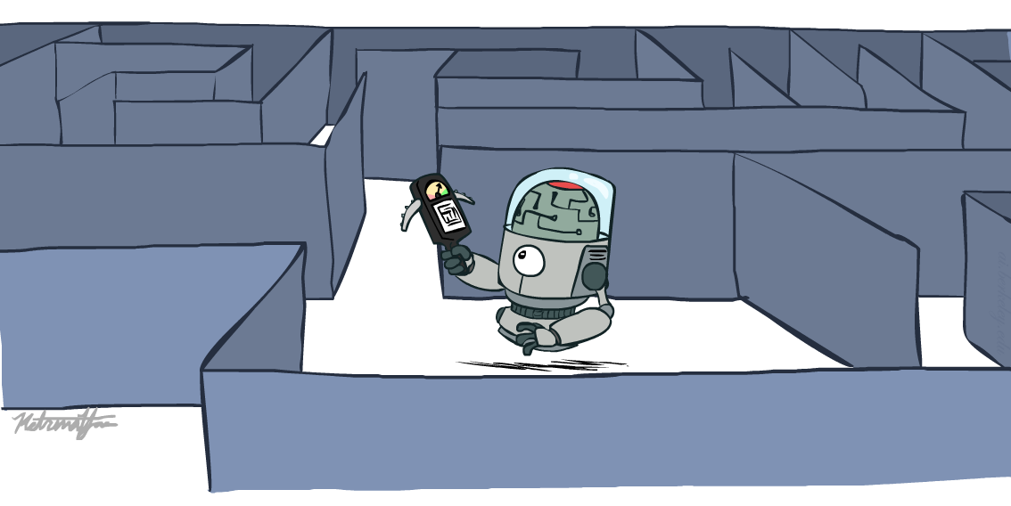
Artificial Intelligence
Search Continued
Slides by Dan Klein, Pieter Abbeel, Anca Dragan (ai.berkeley.edu)
Notes:
Please retain proper attribution, including the reference to ai.berkeley.edu. Thanks!

Slide 2
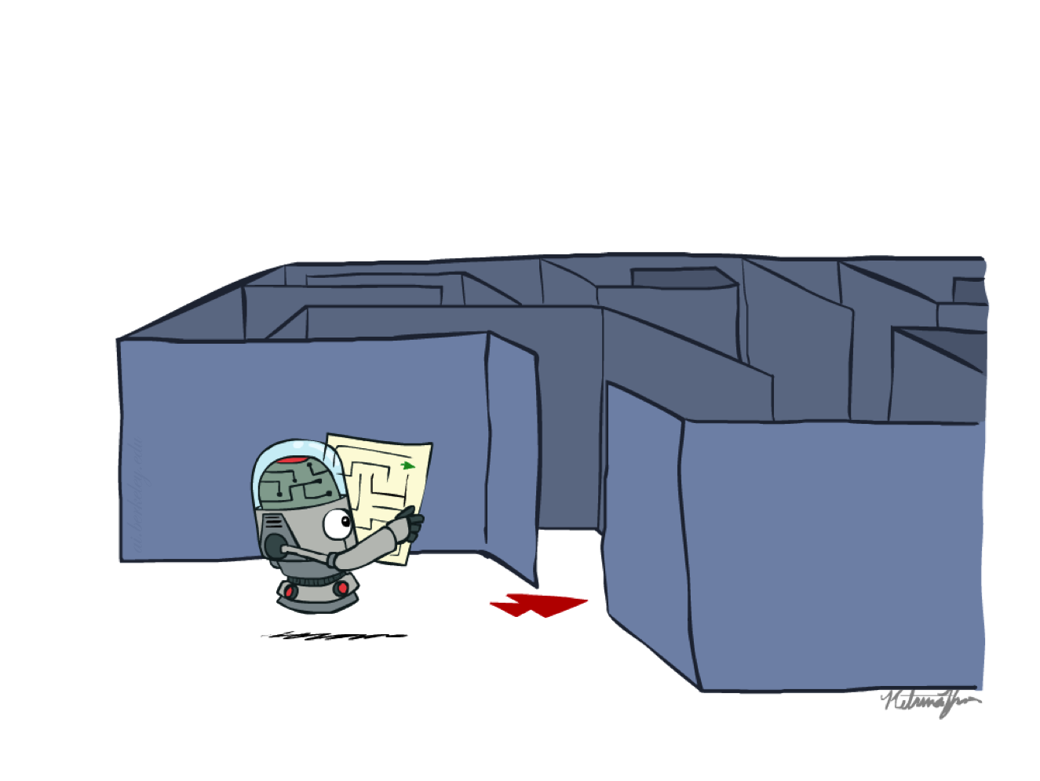
Recap: Search

Slide 3
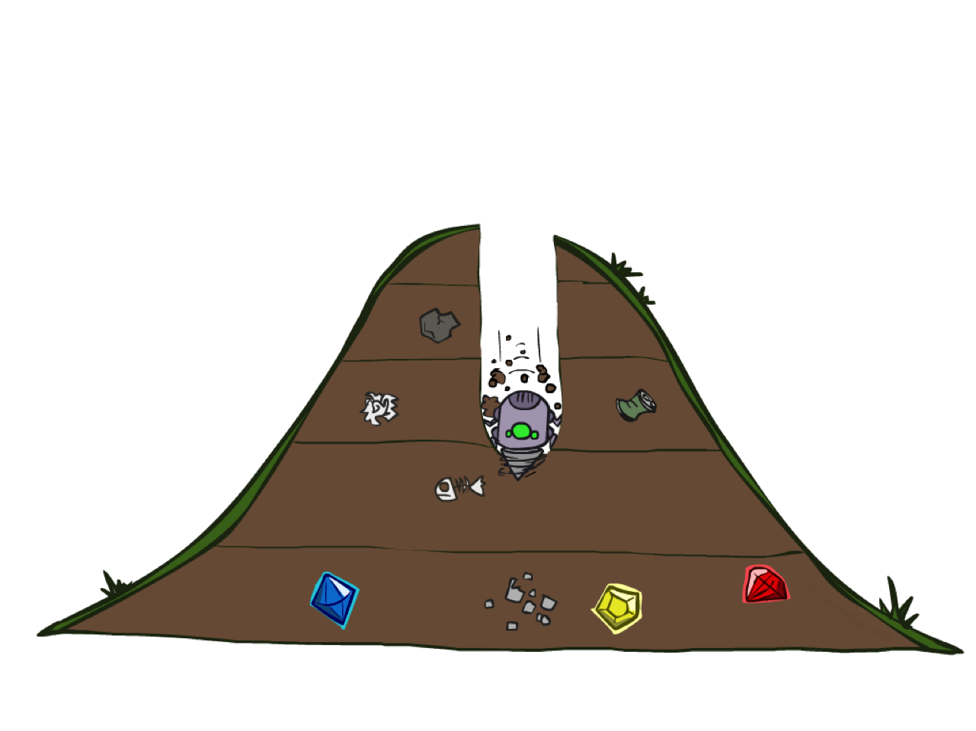
Depth-First (Tree) Search
Notes:
That was generic. Now specific strategy – dfs
Go deep!
Exponentially large at the bottom.

Slide 4
Depth-First Search
Strategy: expand a deepest node first
Implementation: Fringe is a LIFO stack
a
G
a
c
b
c
b
e
d
e
d
f
f
S
h
h
p
p
r
q
r
q
S
d
e
p
b
c
e
h
r
q
a
a
h
r
p
q
f
p
q
f
q
c
G
q
c
G
a
a
Notes:
S D B A C A E H P Q
Ties alphabetically in this case.

Slide 5
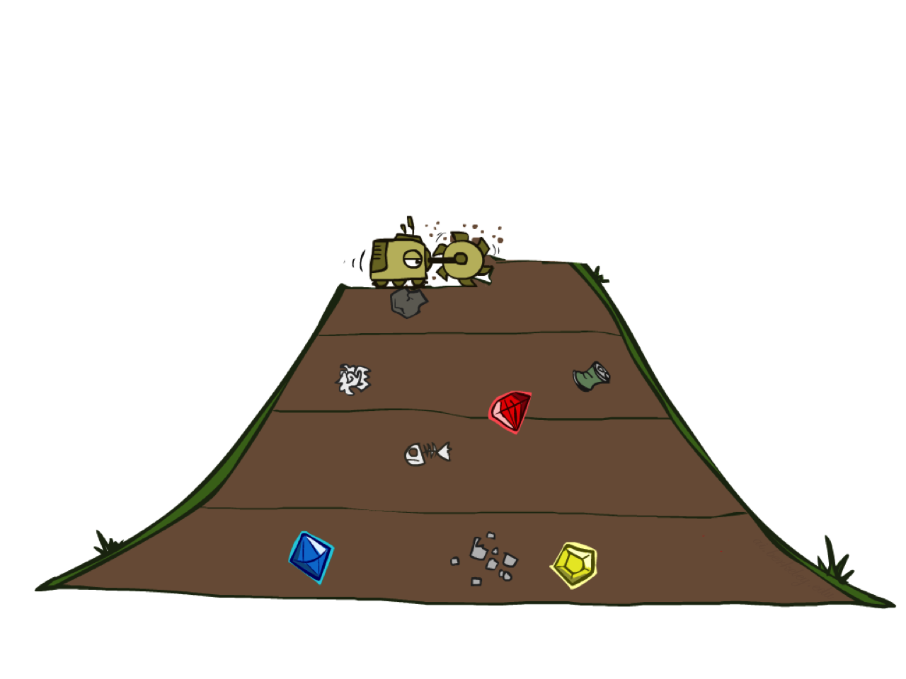
Breadth-First (Tree) Search
Notes:
Another strategy. Layer by layer.
Strip-mining
BFS

Slide 6
Breadth-First Search
Strategy: expand a shallowest node first
Implementation: Fringe is a FIFO queue
a
G
b
c
d
e
f
S
h
p
q
r
S
d
e
p
Search
Tiers
b
c
e
h
r
q
a
a
h
r
p
q
f
p
q
f
q
c
G
q
c
G
a
a
Notes:
Same general algorithm. Shallowest node.
S D E P B C E H R Q

Slide 7
Iterative Deepening
Idea: get DFS’s space advantage with BFS’s time / shallow-solution advantages
Run a DFS with depth limit 1. If no solution…
Run a DFS with depth limit 2. If no solution…
Run a DFS with depth limit 3. …..
Isn’t that wastefully redundant?
Generally most work happens in the lowest level searched, so not so bad!
b
…
Notes:
Another strategy. Combine best of both.
DFS – successor says if deeper than one, stop.
Really common.

Slide 8
Cost-Sensitive Search
a
GOAL
b
c
e
d
f
START
h
p
r
q
Notes:
“Cost Search” What if you have costs associated with arcs? Could you rewrite with what we already know?
Lowest number of actions S->e->r->f->G. Expensive!

Slide 9
Cost-Sensitive Search
a
GOAL
2
2
b
c
3
2
1
8
2
e
d
f
3
9
8
2
START
h
1
4
2
p
4
r
15
q
BFS finds the shortest path in terms of number of actions.
It does not find the least-cost path. We will now cover
a similar algorithm which does find the least-cost path.
How?
Notes:
“Cost Search” What if you have costs associated with arcs? Could you rewrite with what we already know?
Lowest number of actions S->e->r->f->G. Expensive!

Slide 10
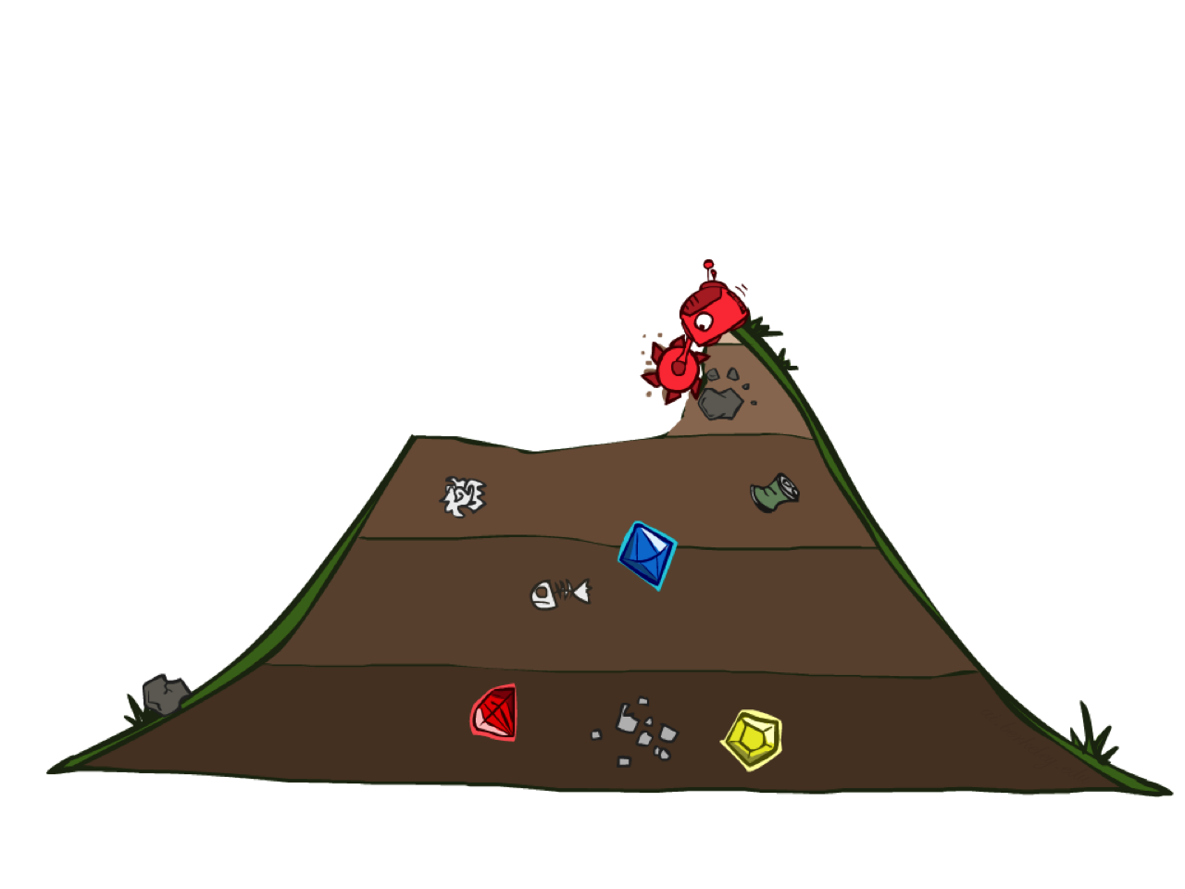
Uniform Cost Search
Notes:
Unfortunate name. It’s a “cost search” that is uniform, not a uniform cost.
Instead of depth, go by cost. Cheap things first, even if multiple actions.

Slide 11
Uniform Cost Search
2
G
a
Strategy: expand a cheapest node first:
Fringe is a priority queue (priority: cumulative cost)
b
c
1
8
2
2
e
3
d
f
9
8
2
S
h
1
1
p
q
r
15
0
S
d
3
e
9
p
1
b
4
e
5
h
17
r
11
q
16
c
11
Cost contours
a
6
a
h
13
r
7
p
q
f
p
q
f
8
q
c
G
q
c
a
11
G
10
a
Notes:
Like breadth first, but with costs. Label with cumulative cost.
Goal path not victory until try to expanded.
Contours show equal cost.

Slide 12
Uniform Cost Search (UCS) Properties
What nodes does UCS expand?
Processes all nodes with cost less than cheapest solution!
If that solution costs C* and arcs cost at least ε , then the “effective depth” is roughly C*/ε
Takes time O(b^{C*/ε}) (exponential in effective depth)
How much space does the fringe take?
Has roughly the last tier, so O(b^{C*/ε})
Is it complete?
Assuming best solution has a finite cost and minimum arc cost is positive, yes! (if no solution, still need depth != ∞)
Is it optimal?
Yes! (Proof via A*)
b
c ≤ 1
…
C*/ε “tiers”
c ≤ 2
c ≤ 3
Notes:
Let’s say C* is 10 and minimum step size is 2. How deep in the tree? C*/e = 5. How many nodes is that?

Slide 13
Uniform Cost Issues
Remember: UCS explores increasing cost contours
The good: UCS is complete and optimal!
The bad:
Explores options in every “direction”
No information about goal location
We’ll fix that soon!
…
c ≤ 1
c ≤ 2
c ≤ 3
Start
Goal
Notes:
What if you know the goal?

Slide 14
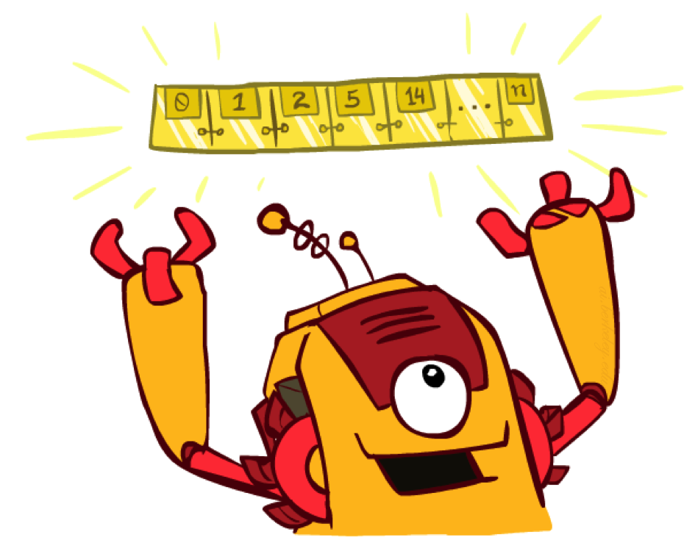
The One Queue
All these search algorithms are the same except for fringe strategies
Conceptually, all fringes are priority queues (i.e. collections of nodes with attached priorities)
Practically, for DFS and BFS, you can avoid the log(n) overhead from an actual priority queue, by using stacks and queues
Can even code one implementation that takes a variable queuing object

Slide 15
Same search function, pass different search strategies

Slide 16

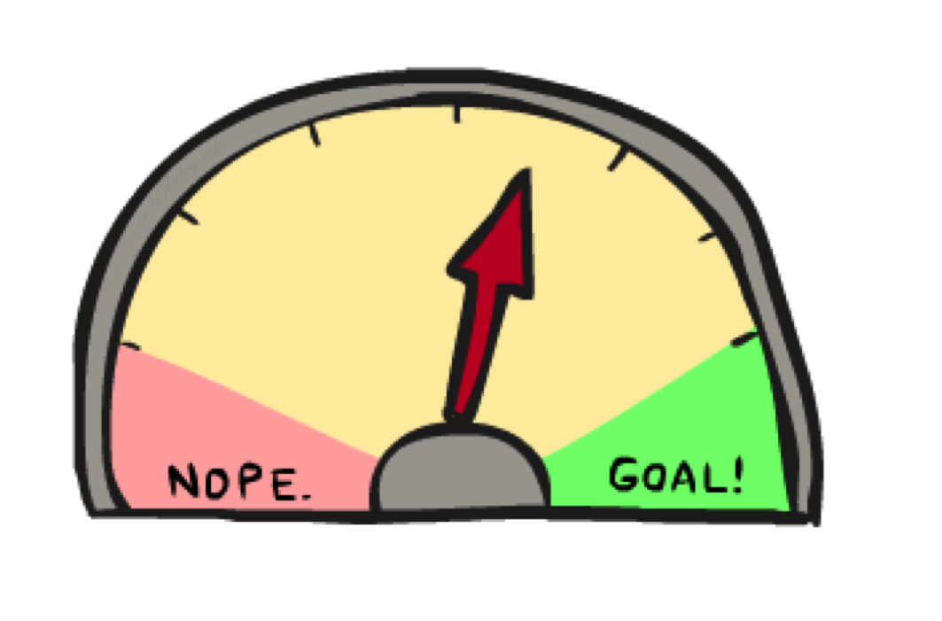
Up next: Informed Search
Uninformed Search (Blind)
DFS
BFS
UCS
Informed Search ( has Info about where goal is)
Heuristics
Greedy Search
A* Search
Graph Search
Notes:
Blind search vs. “warmer” “colder”
Info about where goal is.
Optimal solution, explore less of the tree.

Slide 17
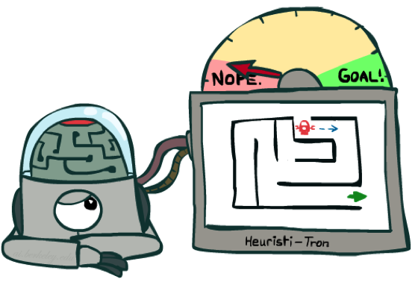
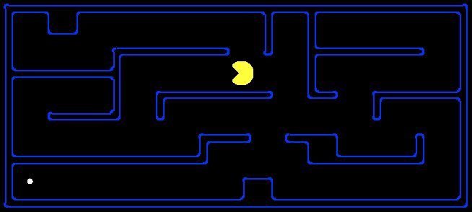
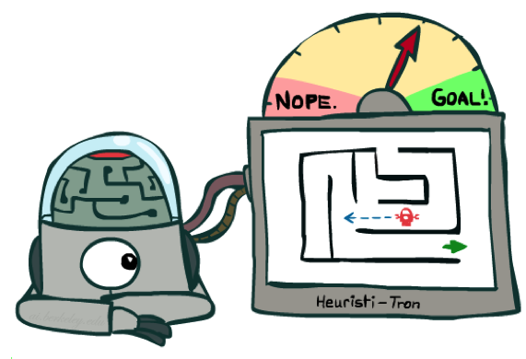
Search Heuristics
A heuristic is:
A function that estimates how close a state is to a goal
Designed for a particular search problem
Pathing?
Examples: Manhattan distance, Euclidean distance for pathing
10
5
11.2
Notes:
Function takes a state, returns a number.
Not everyday term. Not “Look both ways before you cross the street”
How far I am? Could run search, but that defeats the purpose!
Not perfect, but something!

Slide 18
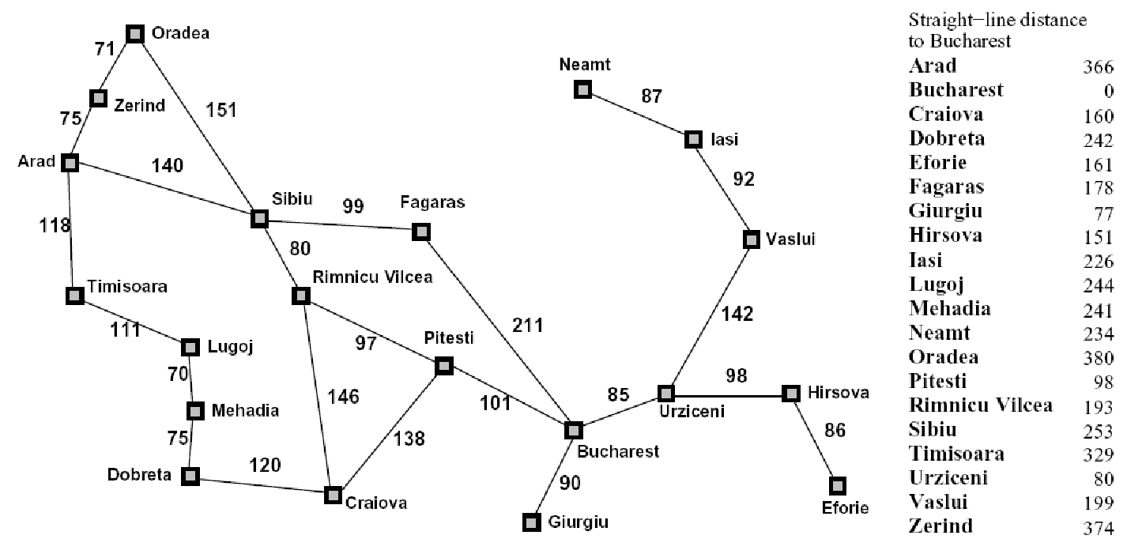
Example: Heuristic Function
Straight line distance
h(x)
Notes:
Another heuristic. Straight line distance (as the crow flies; not as the snail crawls). Better close to Bucharest.
Not always distances, but that’s easiest to understand.
What do you do with it?

Slide 19
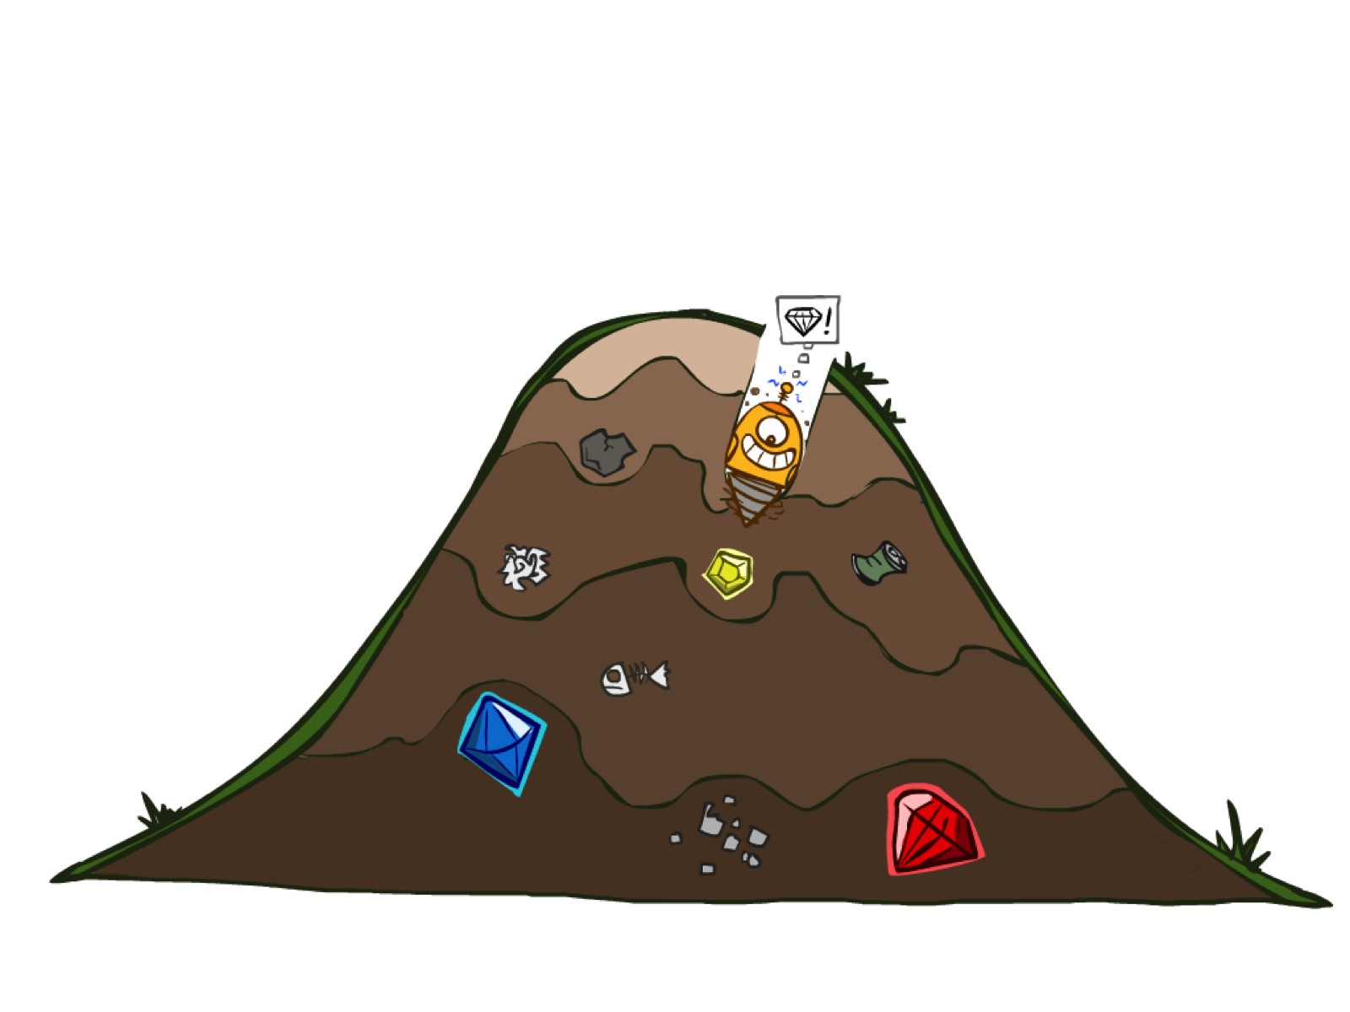
Greedy Search

Slide 20

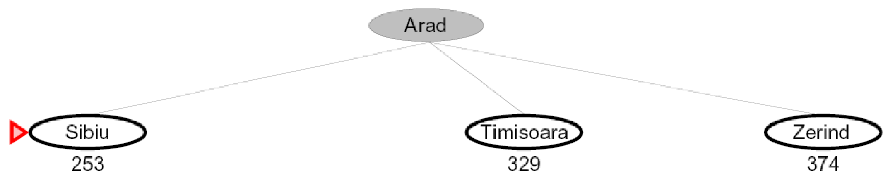
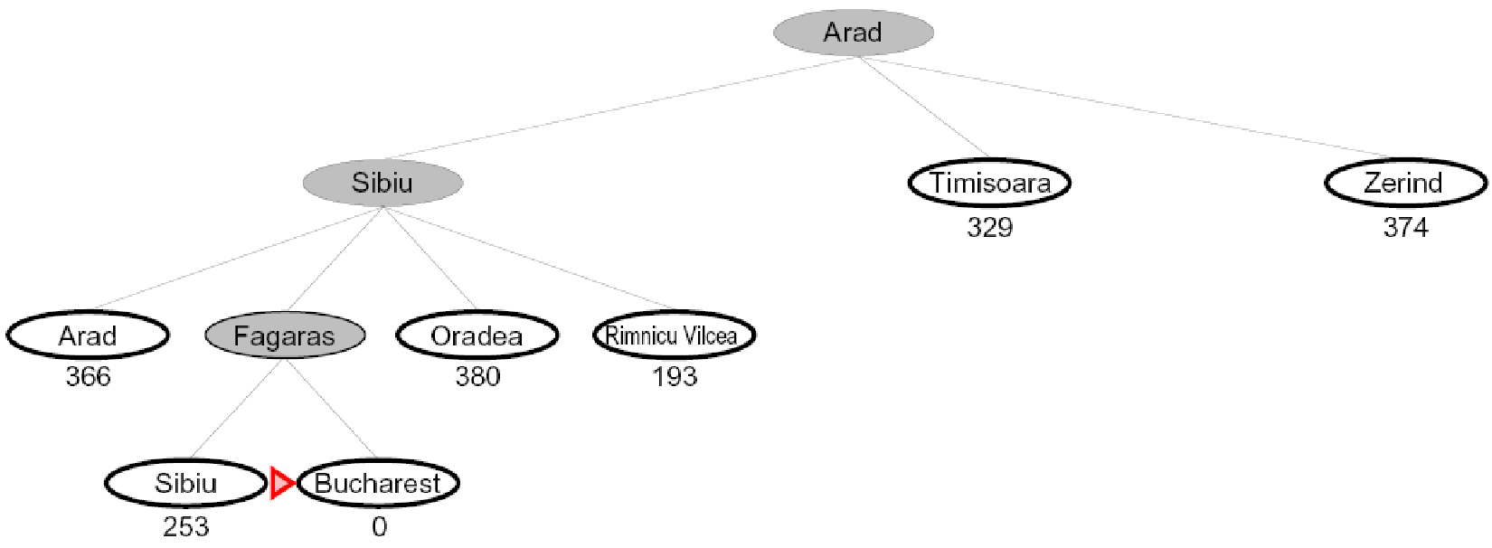
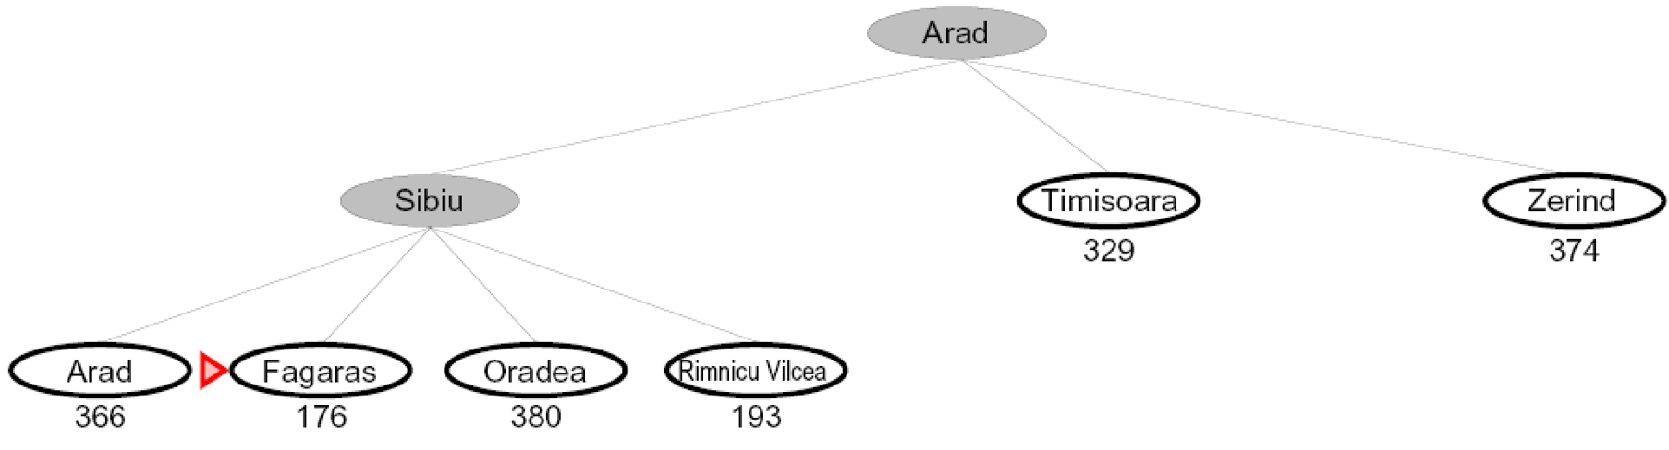
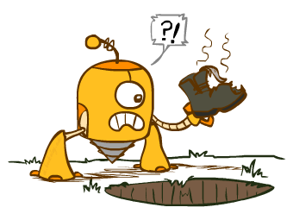
Greedy Search
Expand the node that seems closest…
Is it optimal?
No. Resulting path to Bucharest is not the shortest!
Notes:
Numbers of heuristic, since that’s what greedy cares about.
Got to Bucharest, but not by shortest path.
End up with some kind of goal, but not what you want. You get a smelly shoe instead of to the airport on time.

Slide 21
Greedy Search
b
Strategy: expand a node that you think is closest to a goal state
Heuristic: estimate of distance to nearest goal for each state
A common case:
Best-first takes you straight to the (wrong) goal
Worst-case: like a badly-guided DFS
…
b
…
Notes:
Same algorithm as before, new strategy.
For any search problem, you know the goal. Now, you have an idea of how far away you are from the goal.
Worst: heuristic always wrong. Carefully avoid goal searching all tree.
If your heuristic were really good, sure. But if heuristic is good, easy problem!

Slide 22
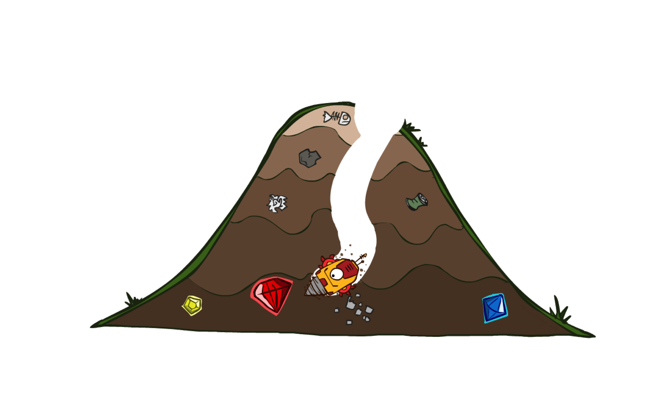
A* Search
Notes:
What we’ve been building to. Cornerstone. Goes to the goal like greedy, but backtracks as needed.
When it works, it’s magic!

Slide 23
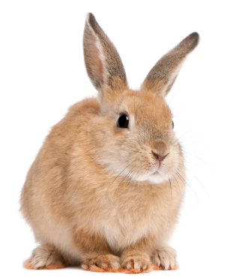
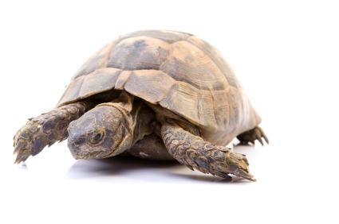
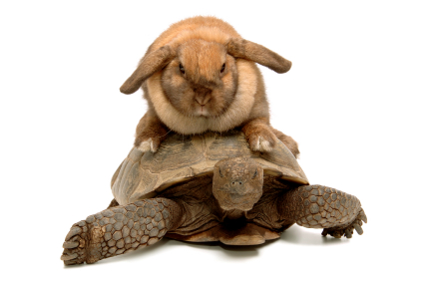
A* Search
UCS
Greedy
A*
Notes:
Notes: these images licensed from iStockphoto for UC Berkeley use.
UCS / Greedy
Goal: The thing that should not be! Hedge bets, be directed.

Slide 24
Combining UCS and Greedy
Uniform-cost orders by path cost, or backward cost g(n)
Greedy orders by goal proximity, or forward cost h(n)
g = 0 h=6
S
8
g = 1 h=5
a
e
h=1
1
g = 2 h=6
g = 4 h=2
g = 9 h=1
b
d
e
1
3
2
S
a
d
G
h=6
h=5
g = 3 h=7
g = 6 h=0
g = 10 h=2
1
h=2
h=0
c
G
d
1
c
b
g = 12 h=0
h=7
h=6
G
A* Search orders by the sum: f(n) = g(n) + h(n)

Slide 25
When should A* terminate?
Should we stop when we enqueue a goal?
No: only stop when we dequeue a goal
h = 2
A
2
2
S
h = 3
h = 0
G
2
B
3
h = 1

Slide 27
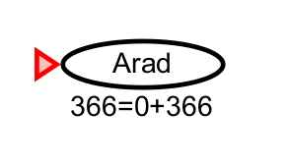
A* search example

Slide 28
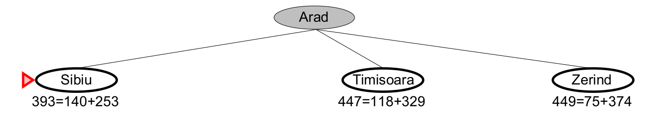
A* search example

Slide 29
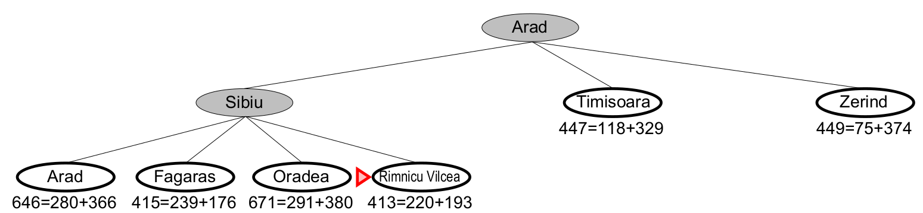
A* search example

Slide 30
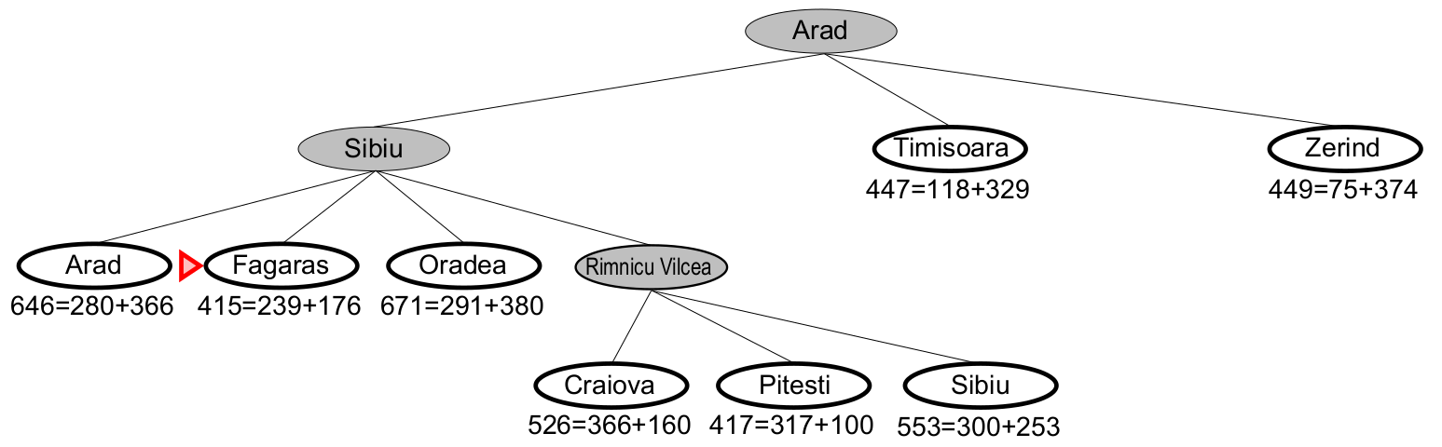
A* search example

Slide 31
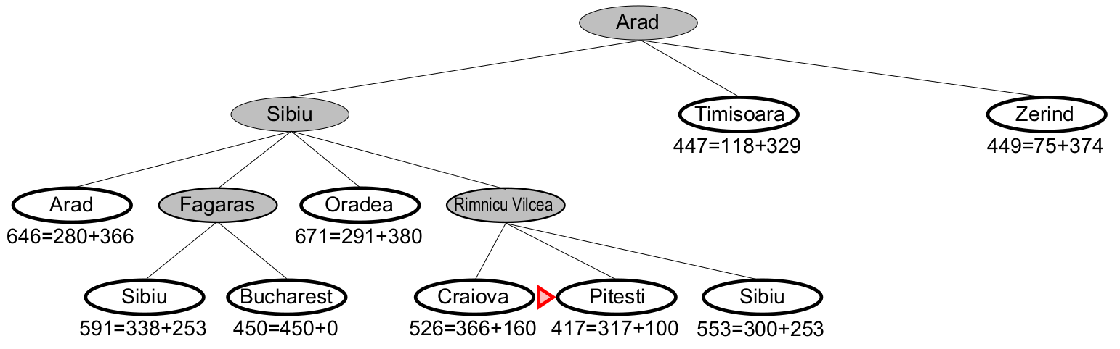
A* search example

Slide 32
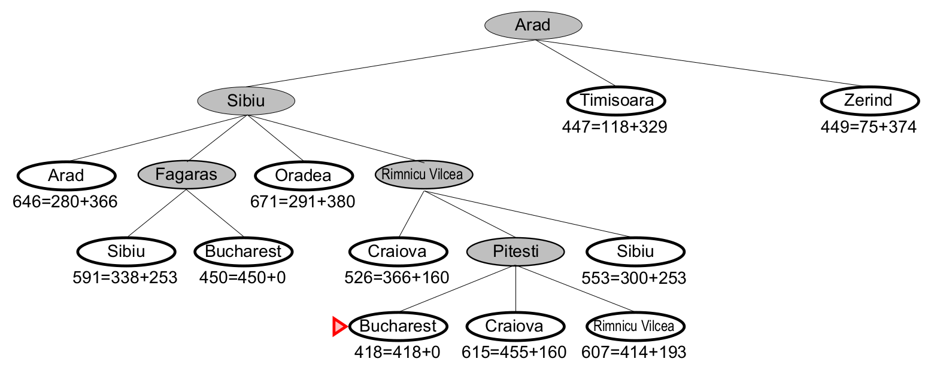
A* search example
http://aispace.org/search/
We stop when the node with the lowest f-value is a goal state.
Is this guaranteed to find the shortest path?

Slide 33
Properties of A*
Uniform-Cost
A*
b
b
…
…
Notes:
UCS ragged based on cost.
A* narrows when near goal, heuristic

Slide 34
UCS vs A* Contours
Uniform-cost expands equally in all “directions”
A* expands mainly toward the goal, but does hedge its bets to ensure optimality
Start
Goal
Start
Goal
Notes:
~10:30

Slide 35
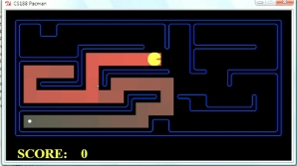
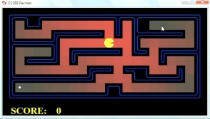
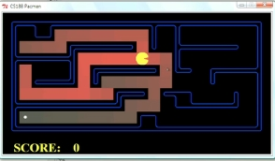
Comparison
Greedy
Uniform Cost
A*

Slide 36
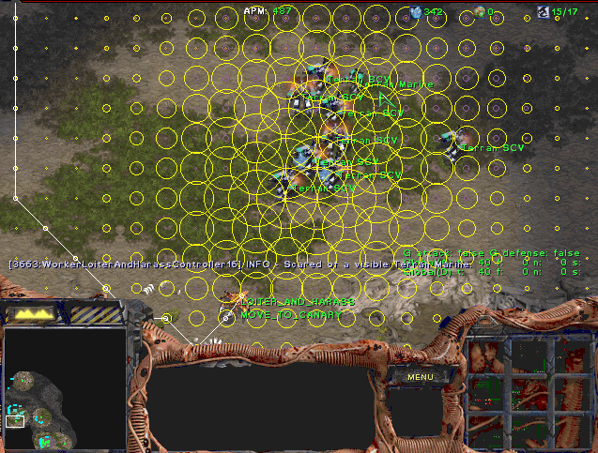
A* Applications
Video games
Pathing / routing problems
Resource planning problems
Robot motion planning
Language analysis
Machine translation
Speech recognition
…
Notes:
Starcraft Overmind

Slide 37
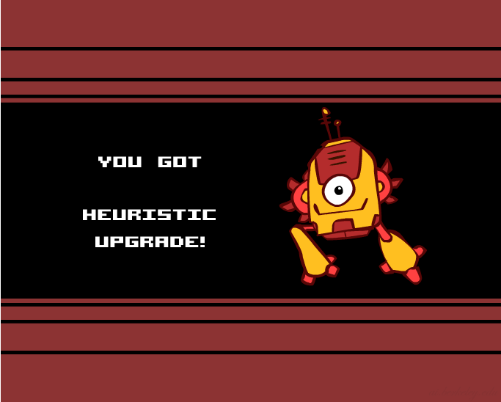
Creating Heuristics
Notes:
Upgrade planning agents with heuristics.
How do we do it?

Slide 38
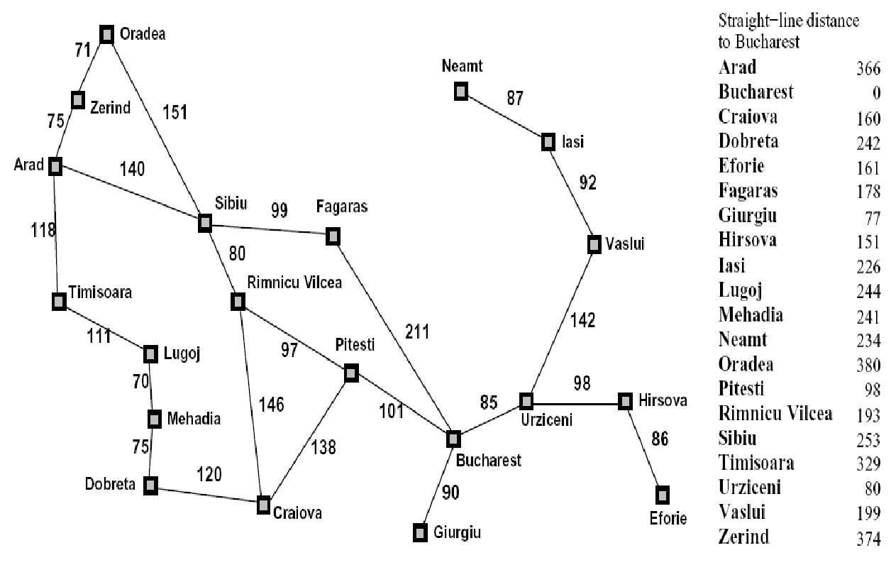
Creating Heuristics
Most of the work in solving hard search problems optimally is in coming up with heuristics
Often, heuristics are solutions to relaxed problems, where new actions are available
366
15
Notes:
Change problem – same or easier. And cheaper.
Imagine a new direct road.
Walk through walls spell.
Inadmissible – a little bit suboptimal is okay.

Slide 39
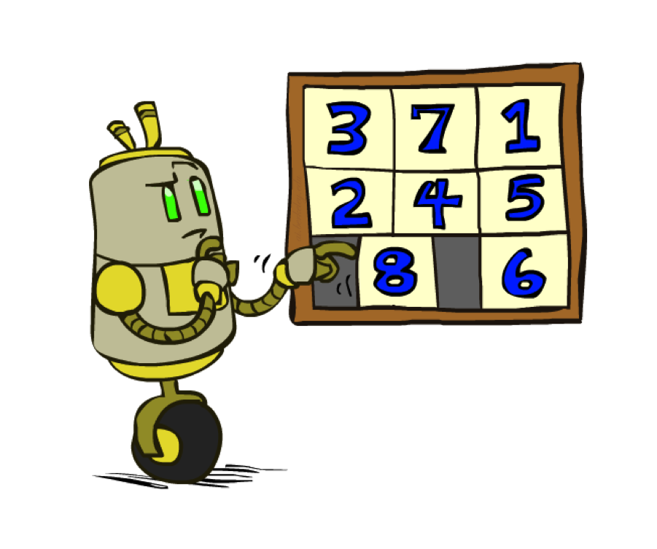
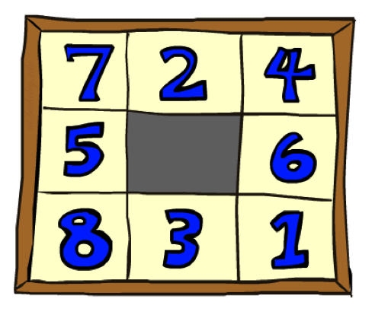
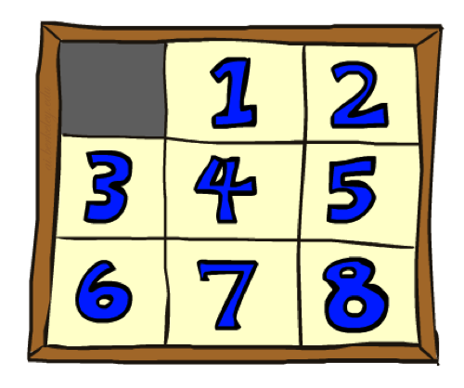
Example: 8 Puzzle
Start State
Actions
Goal State
What are the states?
How many states?
What are the actions?
How many successors from the start state?
What should the costs be?
heuristics?
Notes:
Like the xbox of my time.
Branching factor.

Slide 40
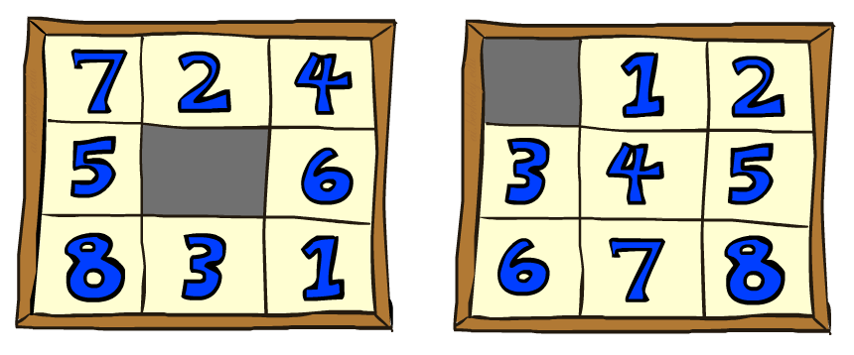
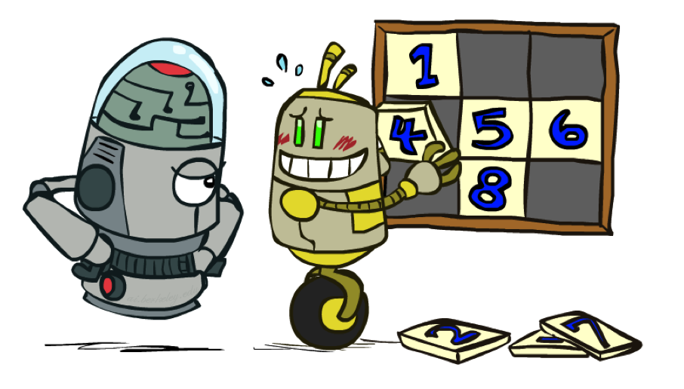
8 Puzzle I
Heuristic: Number of tiles misplaced
h(start) =
This is a relaxed-problem heuristic
8
Start State
Goal State
 | Average nodes expanded when the optimal path has…
 | …4 steps | …8 steps | …12 steps
UCS | 112 | 6,300 | 3.6 x 10⁶
TILES | 13 | 39 | 227
Statistics from Andrew Moore
Notes:
All are out of position. 8
Each tile either goes into it’s right position or not. Fix one mistake, never more than 1.
Cheating is easier.

Slide 41
8 Puzzle II
What if we had an easier 8-puzzle where any tile could slide any direction at any time, ignoring other tiles?
Total Manhattan distance
h(start) =
Start State
Goal State
 | Average nodes expanded when the optimal path has…
 | …4 steps | …8 steps | …12 steps
TILES | 13 | 39 | 227
MANHATTAN | 12 | 25 | 73
3 + 1 + 2 + … = 18
Notes:
Another relaxation, but “harder” than previous.
Lower bound.
Show it’s relaxed or prove.
At LEAST 18 away.
As heuristic gets close to the true cost, you do less search.

Slide 42

A*: Summary

Slide 43

A*: Summary
A* uses both backward costs and (estimates of) forward costs
A* is optimal with consistent heuristics
Heuristic design is key: often use relaxed problems
Notes:
Heuristic is cheaper than reality.

Slide 44
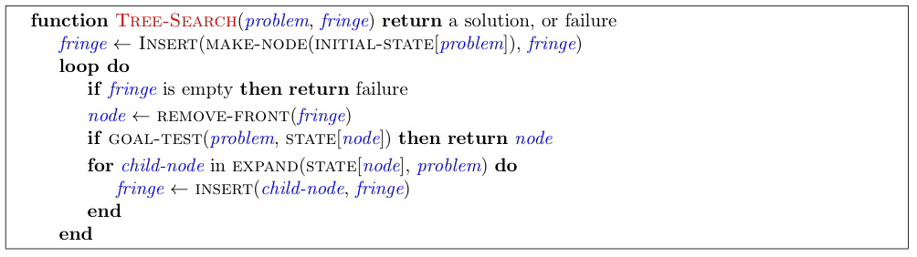
Tree Search Pseudo-Code

Slide 45
The One Queue
All these search algorithms are the same except for fringe strategies
Conceptually, all fringes are priority queues (i.e. collections of nodes with attached priorities)
Practically, for DFS and BFS, you can avoid the log(n) overhead from an actual priority queue, by using stacks and queues
Can even code one implementation that takes a variable queuing object

